Slide 1
Civil Electronic Filing Q&A
Presented by Hawaiʻi State Judiciary
June 7, 2019
Noon to 1 p.m.
Hawaiʻi Supreme Court Courtroom

Slide 2
Agenda
Welcome & introductions
JIMS v. JEFS
What's coming up
Answers to survey questions
Additional questions
Notes:
How presentation will benefit audience: Adult learners are more interested in a subject if they know how or why it is important to them.
Presenter’s level of expertise in the subject: Briefly state your credentials in this area, or explain why participants should listen to you.

Slide 3
Panelists
Judge Gary Chang, moderator, Civil Project sponsor, First Circuit Judge, 14th Division
Mark Santoki, Court Operations Specialist, Civil SME-1st CC Civil
Jamie Chun, Circuit Court Clerk, Civil SME-1st CC Civil
Calvin Ching, Deputy Chief Court Administrator, 1st Circuit
Natalie Ragmat, Supervisor, Legal Docs Branch 2, District Court, SME-1st DC Civil
Velma Kam, JIMS Project Manager
Frank Wegesend, JIMS Business Specialist
Notes:
Lesson descriptions should be brief.

Slide 4
JIMS v. JEFS
JIMS
Judiciary Information Management System
JIMS Portal
(Court Staff)
JEFS
(Attorneys)
eCourt Kokua
(Public)
Notes:
Example objectives
At the end of this lesson, you will be able to:
Save files to the team Web server.
Move files to different locations on the team Web server.
Share files on the team Web server.

Slide 5
What’s coming up
Go live dates
Oct. 7 (District Court)
Oct. 28 (Circuit Court)
Nov. 18 (Land & Tax courts)
Sign up for training
JEFS 101 Overview
Civil JEFS Training
Register in JEFS
Equipment you’ll need
Training manuals

Slide 6
… from the online survey
… from our panelists

Slide 7
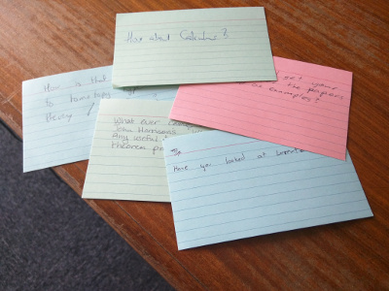

Slide 8
Civil JEFS Information Page
Go to the Civil JEFS Information Page for announcements and FAQs (Frequently Asked Questions).
For future reference, bookmark this page:
www.courts.state.hi.us/civiljefsinfo

